Slide 1

Twitter Sentiment Analysis on Cricket Tweets
-Analyzing Fan Emotions and Reactions Using NLP and Power BI
DHANUJASRI SAGADEVAN
DATA ANALYST

Slide 2
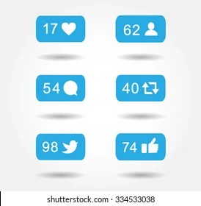
Project Overview
Text Content:
Cricket is one of the most emotionally charged sports worldwide, and social media platforms like Twitter have become the voice of fans. This project captures and analyzes cricket-related tweets to uncover public sentiment and emotional trends during matches.
Key Focus Areas:
Extracting real-time tweets using snscrape.
Cleaning and preprocessing textual data.
Performing sentiment analysis with TextBlob.
Visualizing insights with Power BI dashboards.
Objective Summary:
Transform unstructured text data into actionable insights that can inform media coverage, fan engagement, and marketing strategies.

Slide 3

Problem Statement & Objectives
Problem Statement:
Understanding how fans react to cricket events online is valuable for teams, sponsors, and broadcasters. However, manually analyzing thousands of tweets is impossible — hence, an automated sentiment analysis pipeline was developed.
Objectives:
Identify sentiment trends across thousands of cricket tweets.
Classify tweets into Positive, Negative, or Neutral categories.
Discover emotional shifts during major match moments.
Present insights using interactive dashboards.

Slide 4
Data Collection & Preparation
Source: Twitter data collected using Python’s snscrape (no API key required).
Keywords Used: #Cricket, #INDvsPAK, #CWC2023, #CricketFans.
Data Size: ~8,000 tweets scraped over multiple match days.
Cleaning Steps:
Removed URLs, emojis, mentions, hashtags, and extra spaces.
Converted text to lowercase for uniformity.
Removed stopwords using NLTK.
Extracted relevant columns: date, clean_text, sentiment_score, sentiment_label.
Raw Tweets
Cleaning
Processed Data
Visualization

Slide 5
Sentiment Analysis Process
Detailed Explanation:
Library Used: TextBlob (lexicon-based sentiment analysis).
Each tweet assigned a polarity score:
  0 = Positive sentiment
  = 0 = Neutral sentiment
  < 0 = Negative sentiment
Added sentiment_label column to categorize results.
Validated results by manually checking random tweet samples.
Technical Note:
Although TextBlob is a simple model, it provides a solid baseline for general sentiment polarity. Future upgrades can use advanced NLP models for higher accuracy.

Slide 6
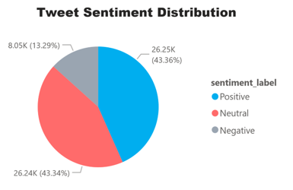
Dashboard & Data Visualization
Dashboard Description:
Created an interactive Power BI dashboard to visualize fan sentiment trends dynamically.
Key Visuals Used:
Bar Chart: Count of Positive, Neutral, and Negative tweets.
Line Chart: Sentiment trend over match timeline.
Pie Chart: Overall sentiment percentage distribution.
Cards: Total Tweets, % Positive, % Negative.
Matrix: Common words in each sentiment category.
Key Insights:
~58% tweets were Positive, 27% Neutral, 15% Negative.
Sentiment spikes were observed during major match victories.
Negative peaks aligned with poor performance or controversial decisions.

Slide 7
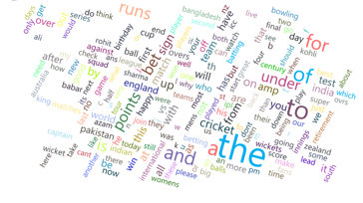
Findings & Interpretation
Detailed Insights:
Emotional Engagement: Fans express more positive emotions during wins, showing strong team loyalty.
Engagement Patterns: Real-time sentiment fluctuates with match progress — positivity rises with boundaries, drops with wickets.
Hashtag Analysis: Hashtags like #Cricket and #INDvsPAK dominate tweet volume, showing event-based engagement peaks.
Impact for Stakeholders:
  Teams: Understand fan mood and improve communication.
  Brands: Identify the best timing for engagement campaigns.
  Media: Use sentiment insights for commentary and story framing.

Slide 8
Conclusion & Recommendations
Conclusion:
Sentiment analysis of cricket tweets reveals that social media is largely a space of positive fan engagement. The majority of tweets show enthusiasm, pride, and support, with negativity rising during controversial moments.
Recommendations:
Sports teams and brands can monitor sentiment dashboards during live matches.
Influencers can tailor content based on trending emotions.
Use feedback patterns to improve fan experience and event communication.

Slide 9
Future Enhancements
Planned Improvements:
Integrate live streaming data via Twitter API for real-time dashboards.
Implement VADER or BERT sentiment models for deeper NLP accuracy.
Add language detection to include non-English tweets.
Compare sentiment across teams, players, or tournaments.
Deploy dashboard as a web-based report for continuous monitoring.

